Slide 1
Introduction to Algorithms
Notes:
Don’t forget to introduce yourself and tell them to ask questions and slow you down if youre talking too fast

Slide 2
What is an algorithm?
A set of steps/instructions sequenced in logical order that when followed exactly solves a problem.
Notes:
Create an algorithm on how to make a cup of tea.
What do you notice?
- Some steps can come before others but other steps have to be done in sequence

Slide 3
Algorithms
Algorithmic instructions should be easy to interpret and follow. They usually contain:
Input instructions
Processing instructions
Output instructions
Notes:
Has anyone ever tried to follow a recipe before?

Slide 4
Example problem
Create an algorithm to find the area of the shape below:
10m
5m
Notes:
Do this along with the slides

Slide 5
Ways of representing Algorithms
A numbered list:
Let length = 10 and let width = 5
Use formula to calculate area: length x width
Put result of calculation as the area
Notes:
Create an algorithm on how to make a cup of tea.
What do you notice?
- Some steps can come before others but other steps have to be done in sequence

Slide 6
Ways of representing Algorithms
Input, Process Output:
INPUT:
Let length be 10
Let width be 5
PROCCESS:
Multiply length by width
OUTPUT:
Area is the result of the calculation
Notes:
Create an algorithm on how to make a cup of tea.
What do you notice?
- Some steps can come before others but other steps have to be done in sequence

Slide 7
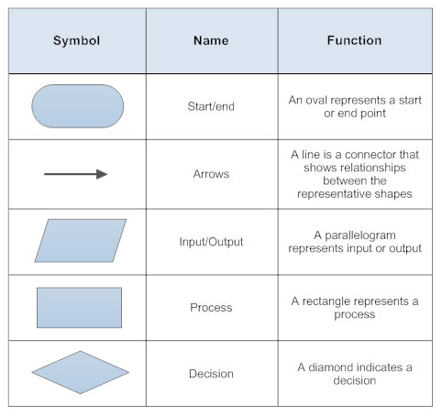
Ways of representing Algorithms
Flow charts
(Picture taken from: https://www.smartdraw.com/flowchart/flowchart-symbols.htm, “Flow Chart Symbols”)
7
Notes:
Create an algorithm on how to make a cup of tea.
What do you notice?
- Some steps can come before others but other steps have to be done in sequence

Slide 8
START
Let width = 5
Let length = 10
Length x width:
5 x 10 = 50
Area = 50
END
Notes:
Create an algorithm on how to make a cup of tea.
What do you notice?
- Some steps can come before others but other steps have to be done in sequence

Slide 9
Challenges – Part One
Create algorithms for the following:
How many square tiles (length defined by user) will cover the floor of a square room of a certain dimension (Easy)
Finding the Prime Numbers between 1 and 100 using only basic arithmetic (Medium)
Direct a person to walk in a polygon with the number and length of sides defined by the user (Challenging)
Notes:
How is this different from the algorithm
Create the algorithm
How would the algorithm change if the users had to get a specific value? E.g Ludo Snakes and Ladders

Slide 10
Class Activity – Draw A Square
Notes:
Play Video
Play game
Ask if everyone is clear on the rules
Ask groups to create list of rules

Slide 11
Draw A Square
Draw a square of length 100 using the Programming language Scratch
Notes:
How is this different from the algorithm
Create the algorithm
How would the algorithm change if the users had to get a specific value? E.g Ludo Snakes and Ladders

Slide 12
Challenges
Notes:
Play Video
Play game
Ask if everyone is clear on the rules
Ask groups to create list of rules

Slide 13

Challenges – Part Two
Create algorithms for the following and implement them using Scratch:
Draw a nonagon (Easy)
Draw a star (use length 100) (Medium)
Draw three stars that touch end to end (Challenging)
Draw a box around the star that touches opposite edges of the star (Challenging)
Notes:
How is this different from the algorithm
Create the algorithm
How would the algorithm change if the users had to get a specific value? E.g Ludo Snakes and Ladders

